Slide 1

A Reactive Online Optimization Based Whole Body Control for Quadruped Locomotion Over Challenging Terrain
[CE554] Mechanical Design of Civil Robot
Team 2
20185570 - Hong Seung woo
20183633 – Choe JongHun
September 19, 2018
Notes:
첫 페이지

Slide 2
Table of Contents
Research Topic
Literature Review
Research Plan
Expected Contribution
Future Work
Notes:
목차

Slide 3
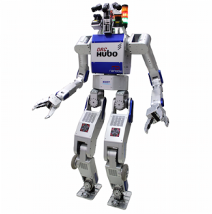
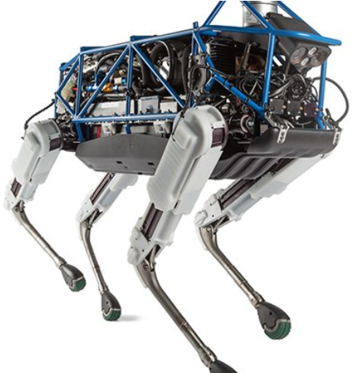
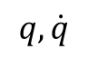
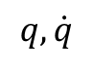
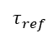
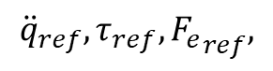
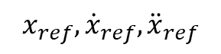
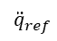
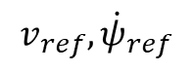
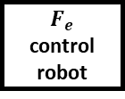
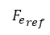
1. Research Topic
$$v_{ref},{\dot{ψ}}_{ref}$$
$$q, \dot{q}$$
High-level controller
$$x_{ref},{\dot{x}}_{ref},{\ddot{x}}_{ref}$$
$$q, \dot{q}$$
Low-level controller
$${\ddot{q}}_{ref},τ_{ref},{F_{e}}_{ref},$$
Plant
$${\ddot{q}}_{ref}$$
$$τ_{ref}$$
$${F_{e}}_{ref}$$
Position control robot
Torque
control robot
$$F_{e}$$
control robot
Notes:
통상적인 로봇 컨트롤 프레임워크에 대한 전반적인 설명

Slide 4
1. Research Topic
Simplified CoM Model
High-level controller
Foot placement (CP) based reference generation
Robustness against disturbance
Highly compliant
Full Body Model
Energy efficient
QP based inverse dynamics
w/ full optimization variables
Low-level controller
Torque control
quadrupedal robot
Plant

Slide 5
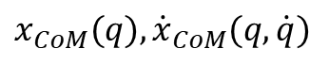
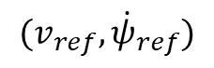
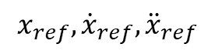
1. Research Topic
Robustness against disturbance
Highly compliant
$$(v_{ref},{\dot{ψ}}_{ref})$$
Energy efficient
(Optimization Based)
CP Controller
$$x_{CoM}(q), {\dot{x}}_{CoM}(q, \dot{q})$$
High-level controller
Constraints
Desired behaviors
Low-level controller
QP solver
$$x_{ref},{\dot{x}}_{ref},{\ddot{x}}_{ref}$$
Plant

Slide 6
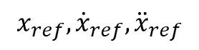
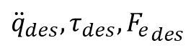
1. Research Topic
Robustness against disturbance
Highly compliant
Energy efficient
High-level controller
Optimization Based
ID Controller
$$x_{ref},{\dot{x}}_{ref},{\ddot{x}}_{ref}$$
Constraints
Desired behaviors
Low-level controller
QP solver
Plant
$${\ddot{q}}_{des}, τ_{des}, {F_{e}}_{des}$$

Slide 7
2. Literature Review
Aghili F (2005) A unified approach for inverse and direct dynamics of constrained multibody systems based on linear projection operator: Applications to control and simulation. IEEE Transactions on Robotics 21(5): 834–849.
Bouyarmane, K., Vaillant, J., Keith, F., & Kheddar, A. (2012). Exploring humanoid robots locomotion capabilities in virtual disaster response scenarios. In 12th IEEE-RAS International Conference on Humanoid Robots (Humanoids) (pp. 337–342), Osaka, Japan.
De Lasa, M., Mordatch, I., & Hertzmann, A. (2010). Featurebased locomotion controllers. ACM Transactions on Graphics, 29(4), 131:1–131:10.
Khatib O (1987) A unified approach for motion and force control of robot manipulators: The operational space formulation. IEEE Journal of Robotics and Automation 3(1): 43–53.
Herzog, A., Righetti, L., Grimminger, F., Pastor, P., & Schaal, S. (2014). Balancing experiments on a torque-controlled humanoid with hierarchical inverse dynamics. In IEEE/RSJ International Conference on Intelligent Robots and Systems (IROS), Chicago.
Hutter, M., Sommer, H., Gehring, C., Hoepflinger, M., Bloesch, M., & Siegwart, R. (2014). Quadrupedal locomotion using hierarchical operational space control. The International Journal of Robotics Research, 33(8), 1047–1062.
Feng, S., Whitman, E., Xinjilefu, X., & Atkeson, C. G. (2015). Optimization‐based full body control for the DARPA Robotics Challenge. Journal of Field Robotics, 32(2), 293-312.
Mistry M, Buchli J and Schaal S (2010) Inverse dynamics control of floating base systems using orthogonal decomposition. In: Proceedings of International conference on robotics and automation (ICRA), Anchorage, AK, 3–8 May 2010, pp. 3406–3412.
Sentis L (2007) Synthesis and control of whole-body behaviors in humanoid systems. PhD Thesis, Stanford University.
Raibert, M. H. (1986). Legged robots that balance. MIT press.
Vukobratović, M., & Borovac, B. (2004). Zero-moment point—thirty five years of its life. International journal of humanoid robotics, 1(01), 157-173.
Pratt, J., Carff, J., Drakunov, S., & Goswami, A. (2006, December). Capture point: A step toward humanoid push recovery. In Humanoid Robots, 2006 6th IEEE-RAS International Conference on (pp. 200-207). IEEE.
Rebula, J., Canas, F., Pratt, J., & Goswami, A. (2007, November). Learning capture points for humanoid push recovery. In Humanoid Robots, 2007 7th IEEE-RAS International Conference on (pp. 65-72). IEEE.

Slide 8
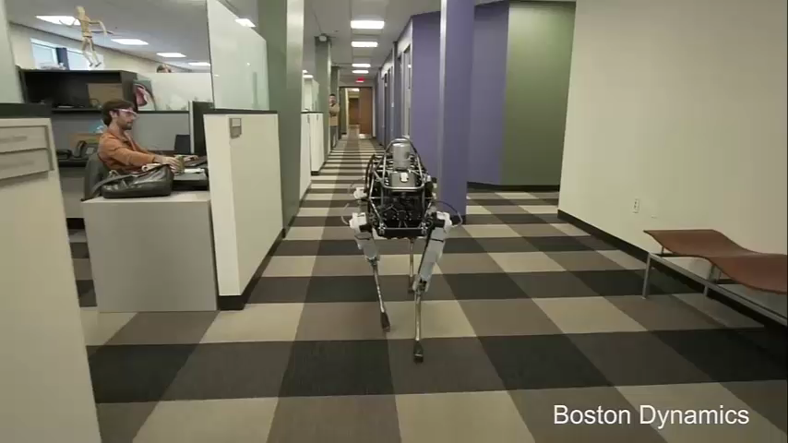
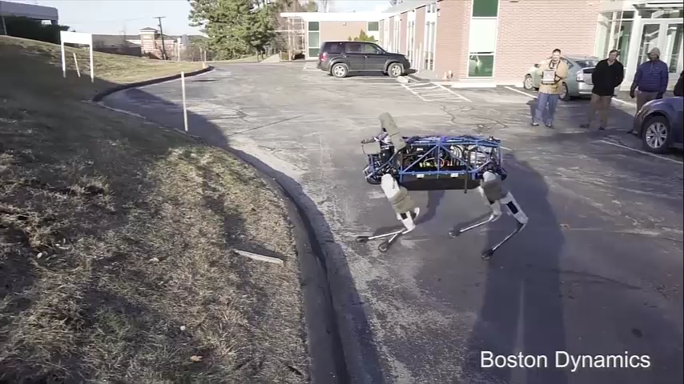
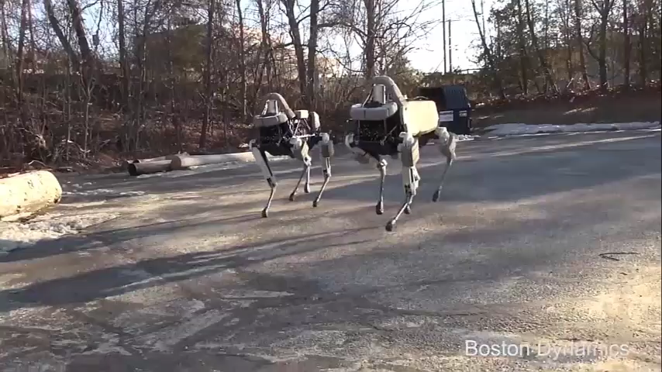
3. Research Plan – Time Table
Baseline (Comparison Target)
Push Recovery
Walking on Sloped Terrain
Dynamic Locomotion

Slide 9
3. Research Plan – Time Table
승우: Low-level Controller
종훈: High-level Controller
Learn how to use QP, RBDL (standard solver)
Coding and debugging high, low-level controller
Coding and debugging high, low-level controller

Slide 10
4. Expected Contribution
An intuitive and simple framework based on two levels of optimization: high-level controller is responsible for reactive balance recovery, low-level controller is used to find optimal control to track the desired motion.
We will illustrate the performance of the QP based controller, which is largely depends on the selection of the constraint and behavior objectives
We will design appropriate quadratic cost functions that best suits for the quadruped robot working in the challenging environment.
We will verify and show that the proposed optimization control framework can robustly stabilize the quadruped robot under large external disturbances.

Slide 11
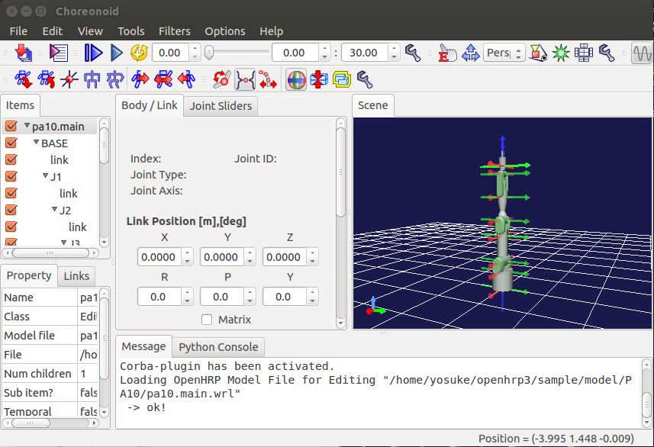
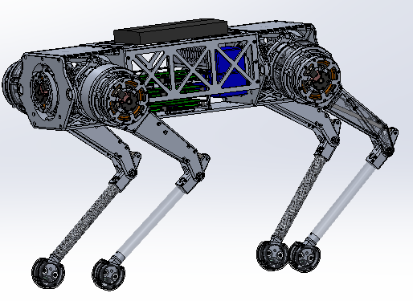
5. Future Work
Select appropriate Quadratic Programming, Rigid Body Dynamics solver
Choreonoid simulator install & tutorial
Do RESEARCH!!
Test on full-body simulator
(Test on real quadrupedal robot)

Slide 12


